Slide 1
Introduction to Java
Methods

Slide 2

Defining Methods
A method is a collection of statements that are grouped together to perform an operation.

Slide 3
Method Signature
Method signature is the combination of the method name and the parameter list.

Slide 4
Formal Parameters
The variables defined in the method header are known as formal parameters.

Slide 5
Actual Parameters
When a method is invoked, you pass a value to the parameter. This value is referred to as actual parameter or argument.

Slide 6
Return Value Type
A method may return a value. The returnValueType is the data type of the value the method returns. If the method does not return a value, the returnValueType is the keyword void. For example, the returnValueType in the main method is void.

Slide 7
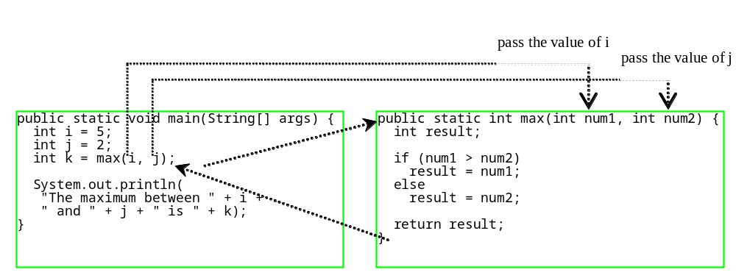
Calling Methods

Slide 8

CAUTION
A return statement is required for a value-returning method. The method shown below in (a) is logically correct, but it has a compilation error because the Java compiler thinks it possible that this method does not return any value.
To fix this problem, delete if (n < 0) in (a), so that the compiler will see a return statement to be reached regardless of how the if statement is evaluated.

Slide 9


Trace Call Stack
i is declared and initialized

Slide 10
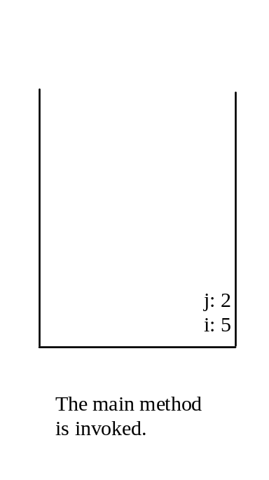
Trace Call Stack
j is declared and initialized

Slide 11

Trace Call Stack
Declare k

Slide 12
Trace Call Stack
Invoke max(i, j)

Slide 13

Trace Call Stack
pass the values of i and j to num1 and num2

Slide 14

Trace Call Stack
pass the values of i and j to num1 and num2

Slide 15
Trace Call Stack
(num1 > num2) is true

Slide 16

Trace Call Stack
Assign num1 to result

Slide 17

Trace Call Stack
Return result and assign it to k

Slide 18

Trace Call Stack
Execute print statement

Slide 19
void Method Example
This type of method does not return a value. The method performs some actions.
public static void main(String[] args) {
System.out.print("The grade is ");
printGrade(78.5);
}
public static void printGrade(double score) {
if (score >= 90.0) System.out.println('A');
else if (score >= 80.0) System.out.println('B');
else if (score >= 70.0) System.out.println('C');
else if (score >= 60.0) System.out.println('D');
else System.out.println('F');
}

Slide 20
Pass by Value – Example
Program demonstrates passing values to the methods.

Slide 21
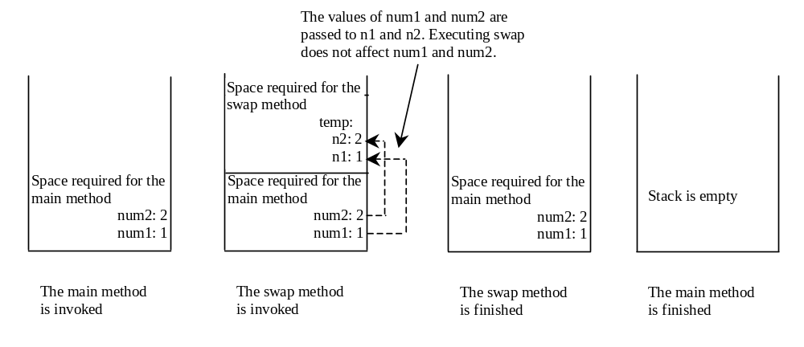
Pass by Value, cont.

Slide 22
Overloading Methods
public static int max (int num1, int num2) {
if (num1 > num2)
return num1;
else
return num2;
}
public static double max(double num1, double num2) {
if (num1 > num2)
return num1;
else
return num2;
}
Invoking:
max(3,4);
max(3.0, 5.0);
max(2, 3.5); → which max method is invoked?

Slide 23
Ambiguous Invocation
Sometimes there may be two or more possible matches for an invocation of a method, but the compiler cannot determine the most specific match. This is referred to as ambiguous invocation. Ambiguous invocation is a compilation error.

Slide 24
Ambiguous Invocation
public class AmbiguousOverloading {
public static void main(String[] args) {
System.out.println(max(1, 2));
}
public static double max(int num1, double num2) {
if (num1 > num2)
return num1;
else
return num2;
}
public static double max(double num1, int num2) {
if (num1 > num2)
return num1;
else
return num2;
}
}

Slide 25
Scope of Local Variables
Local variable:
a variable defined inside a method.
Scope:
the part of the program where the variable can be referenced.
The scope of a local variable starts from its declaration and continues to the end of the block that contains the variable. A local variable must be declared before it can be used.

Slide 26
Scope of Local Variables, cont.
You can declare a local variable with the same name multiple times in different non-nesting blocks in a method, but you cannot declare a local variable twice in nested blocks.

Slide 27

Scope of Local Variables, cont.
A variable declared in the initial action part of a for loop header has its scope in the entire loop. But a variable declared inside a for loop body has its scope limited in the loop body from its declaration and to the end of the block that contains the variable.

Slide 28

Scope of Local Variables, cont.

Slide 29
Scope of Local Variables, cont.
public static void testMethod() {
int x = 1;
int y = 1;
// i is declared
for (int i = 1; i < 10; i++) {
x += i;
}
// i is declared again
for (int i = 1; i < 10; i++) {
y += i;
}
}
Correct method – no compiler errors

Slide 30
Scope of Local Variables, cont.
public static void testMethod()
{
int x = 1;
int y = 1;
for (int i = 1; i < 10; i++)
{
int x = 0;
x += i;
}
}
Incorrect method – compiler errors

Slide 31

Method Abstraction
You can think of the method body as a black box that contains the detailed implementation for the method.

Slide 32
The Math Class
Class constants:
  PI
  E
Class methods:
  Trigonometric Methods
  Exponent Methods
  Rounding Methods
  min, max, abs, and random Methods

Slide 33
Trigonometric Methods
sin(double a)
cos(double a)
tan(double a)
acos(double a)
asin(double a)
atan(double a)
Examples:
Math.sin(0) returns 0.0
Math.sin(Math.PI / 6) returns 0.5
Math.sin(Math.PI / 2) returns 1.0
Math.cos(0) returns 1.0
Math.cos(Math.PI / 6) returns 0.866
Math.cos(Math.PI / 2) returns 0

Slide 34
Exponent Methods
exp(double a)
  Returns e raised to the power of a.
log(double a)
  Returns the natural logarithm of a.
log10(double a)
  Returns the 10-based logarithm of a.
pow(double a, double b)
  Returns a raised to the power of b.
sqrt(double a)
  Returns the square root of a.
Examples:
Math.exp(1) returns 2.71
Math.log(2.71) returns 1.0
Math.pow(2, 3) returns 8.0
Math.pow(3, 2) returns 9.0
Math.pow(3.5, 2.5) returns 22.91765
Math.sqrt(4) returns 2.0
Math.sqrt(10.5) returns 3.24

Slide 35
Rounding Methods
double ceil(double x)
  x rounded up to its nearest integer. This integer is returned as a double value.
double floor(double x)
  x is rounded down to its nearest integer. This integer is returned as a double value.
double rint(double x)
  x is rounded to its nearest integer. If x is equally close to two integers, the even one is returned as a double.
int round(float x)
  Return (int)Math.floor(x+0.5).
long round(double x)
  Return (long)Math.floor(x+0.5).

Slide 36
min, max, and abs
max(a, b)and min(a, b)
  Returns the maximum or minimum of two parameters.
abs(a)
  Returns the absolute value of the parameter.
random()
  Returns a random double value
  in the range [0.0, 1.0).
Examples:
Math.max(2, 3) returns 3
Math.max(2.5, 3) returns 3.0
Math.min(2.5, 3.6) returns 2.5
Math.abs(-2) returns 2
Math.abs(-2.1) returns 2.1

Slide 37
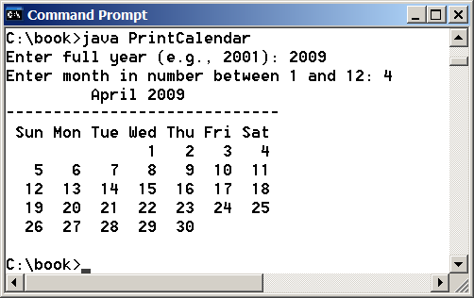
PrintCalendar – Example 7
Let us use the PrintCalendar example to demonstrate the stepwise refinement approach.

Slide 38

Design Diagram

Slide 39
Design Diagram

Slide 40
Design Diagram

Slide 41
Design Diagram

Slide 42
Design Diagram

Slide 43
Design Diagram

Slide 44
Implementation: Top-Down
Top-down approach is to implement one method in the structure chart at a time from the top to the bottom. Stubs can be used for the methods waiting to be implemented. A stub is a simple but incomplete version of a method. The use of stubs enables you to test invoking the method from a caller. Implement the main method first and then use a stub for the printMonth method.

Slide 45
Implementation: Bottom-Up
Bottom-up approach is to implement one method in the structure chart at a time from the bottom to the top. For each method implemented, write a test program to test it. Both top-down and bottom-up methods are fine. Both approaches implement the methods incrementally and help to isolate programming errors and makes debugging easy. Sometimes, they can be used together.

